Slide 1


Journey to Reverse Engineering
Binary and Beyond
January 16th, 2021

Slide 2
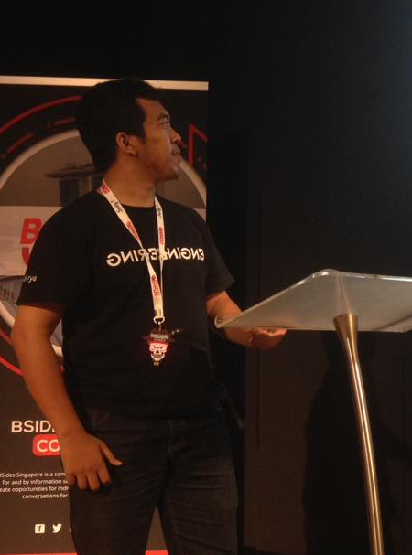
Who am I?
Hi!
Satria Ady Pradana
Ordinary Cyber Security Guy
Cyber Security Consultant of Mitra Integrasi Informatika
Penetration Tester, Red Team
IoT / OT Cyber Security Special Interest Group
Community Leader of Reversing.ID
Love Low-Level Stuffs

Slide 3
Agenda
01
02
03
Zen of Reversing
Binary and Beyond
Challenges & Opportunities
Basic Principle, Tools, and Common Practice

Slide 4

01
Zen of Reversing

Slide 5

Reversing is …
Cracking??

Slide 6

The Terms
What is Reverse Engineering?
“Art and Science of understanding the mechanics of man-made creation, extracting the design, and recreate anything based on the knowledge.”
Originally used in the context of mechanical engineering.
Emphasize on analysis.
Overlap/use many fields.
Add a footer

Slide 7
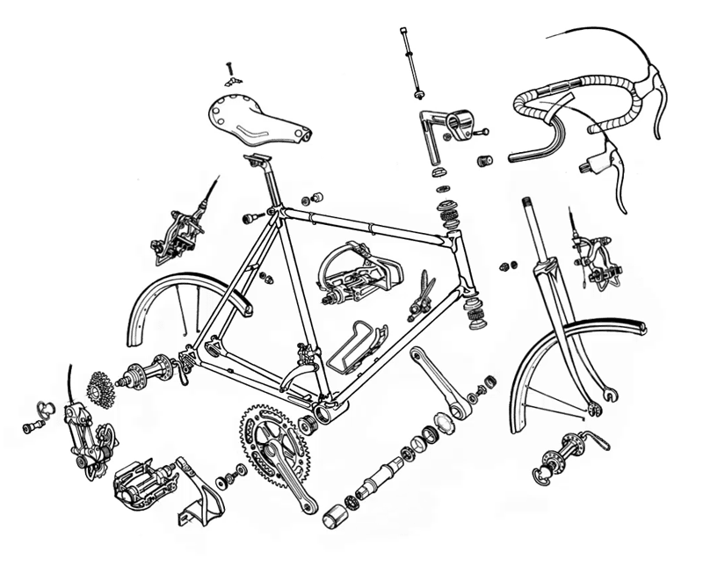

Slide 8
Reverse Engineering
“Knowledge is power, but only wisdom is strength.”
Exploring something unknown.
Solving mysteries.
Observe how thing works.
Modify or replicate

Slide 9

Motivation
What drives people do Reversing?
Interfacing
Improve documentation shortcomings
Bug Fixing
Creation of unlicensed duplicates
Repurposing
Finding security bugs
For fun!

Slide 10
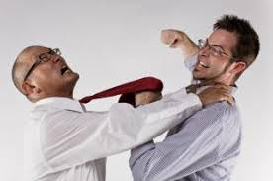

Continuous Rivalry
Developer vs Reverser
Reverse engineer and developer compete each other.
Developer want to protect their intellectual property
Reverse engineer want to break the protection.
Who will win?

Slide 11


Slide 12
Basic Principles
Formalizing the reverse engineering
Comprehension
Decomposition
Reconstruction
Secret Art of Alchemy Reversing

Slide 13
Basic Principles: Comprehension
Gaining the knowledge of anything related to the target
Identification
Programming languages
compilers.
Packer or protection
library
Static Analysis
Dynamic Analysis

Slide 14
Basic principle: Decomposition
Breaking the system structures to small components
Get the global view.
Identify important components.
Graph and trace the flow.
Grouping.

Slide 15
Basic Principle: Reconstruction
Creating something based on the extracted knowledge.
Recreate the product.
Modify some parts.
Removing some components.
Add new features.
Documentation.

Slide 16

02
From Binary and Beyond

Slide 17
Reversing is not limited to binary

Slide 18

Target of Reversing
Code (software)
Machine (hardware)
Data (format, database, protocol)
etc, etc, etc

Slide 19
(Simple) Code Reversing Pipeline
Disassembly
Binary
Assembly
Code
Decompile
19

Slide 20

Binary analysis
Analyze how program works and behave
Disassembly
Decompile
Debugging
Instrumentation
Code Emulation
Symbolic Execution

Slide 21
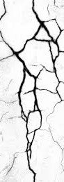
Binary modification
Modification outside of Developer Control
Byte Patching
Control-Flow Bypass
Resource Modification
Keygen

Slide 22
Is Assembly Language Mandatory?
YES
NO
Delphi
JavaScript
MIPS
Java
Python
ARM
PHP
x86
PowerPC
.NET

Slide 23
Cryptography?
Programming?

Slide 24
Tools
For Software Reverse Engineering
Binary Format Identifier
Hex Editors
Disassemblers
Decompilers
Debuggers
Dynamic Binary Instrumentation
Code Emulators
Packet Analysis
https://github.com/ReversingID/Awesome-Reversing/blob/master/_software.md

Slide 25
Binary Format Identifier
Focus on:
Binary type (PE, ELF, etc)
Import-library List
Entropy view
Packer identification
Development tools identification (compiler, linker, etc)
Sections list
Hash
Signature matching
Detect It Easy
PeStudio
PEiD
PPEE

Slide 26
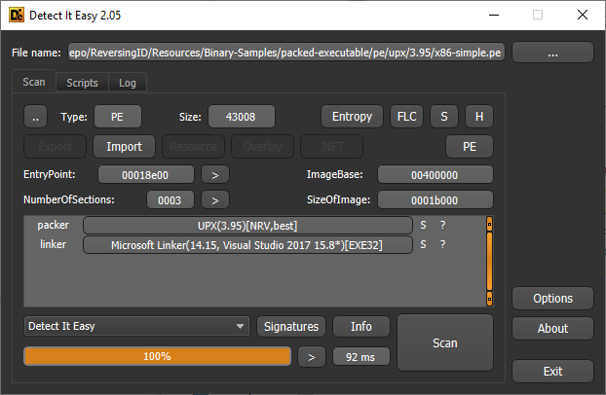

Slide 27
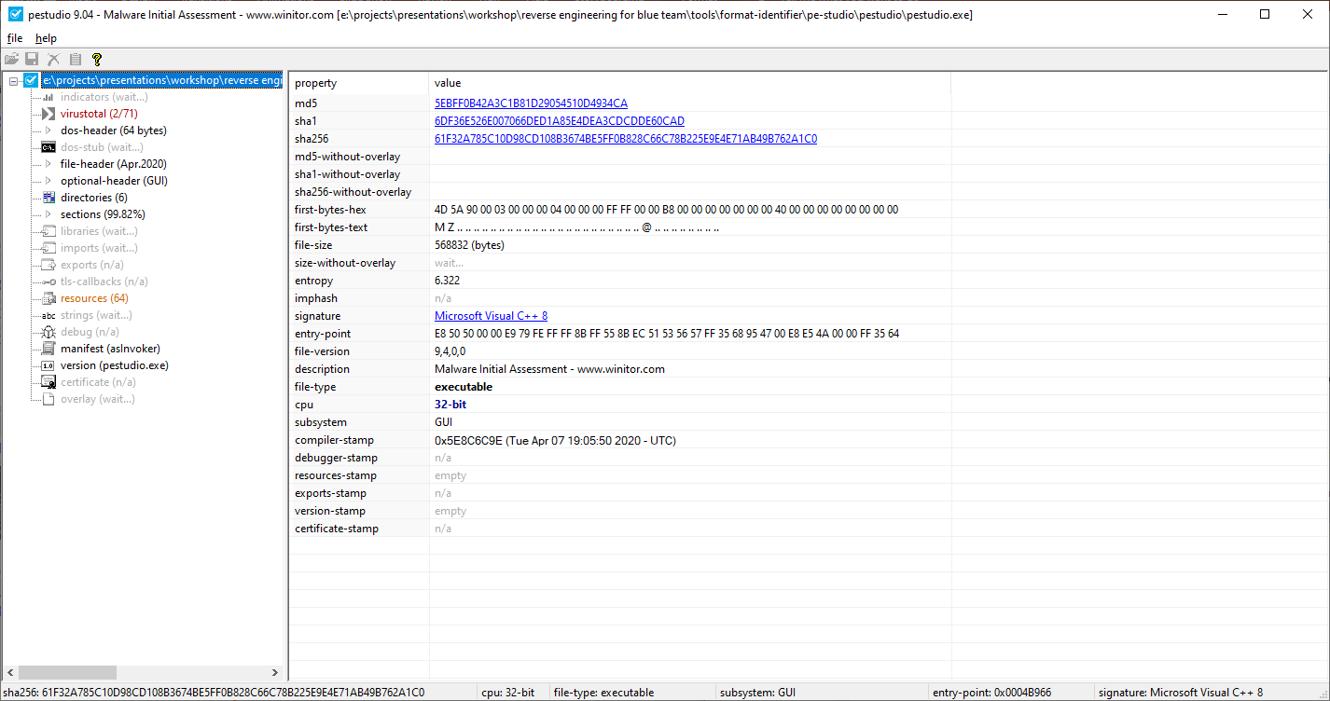

Slide 28
Disassembler & Decompiler
Focus on:
Search and filter symbols
Cross-referencing
Symbol renaming
Control-Flow Graph
Type recovery
IDA Pro
Ghidra
Binary Ninja
Radare2 + Cutter

Slide 29
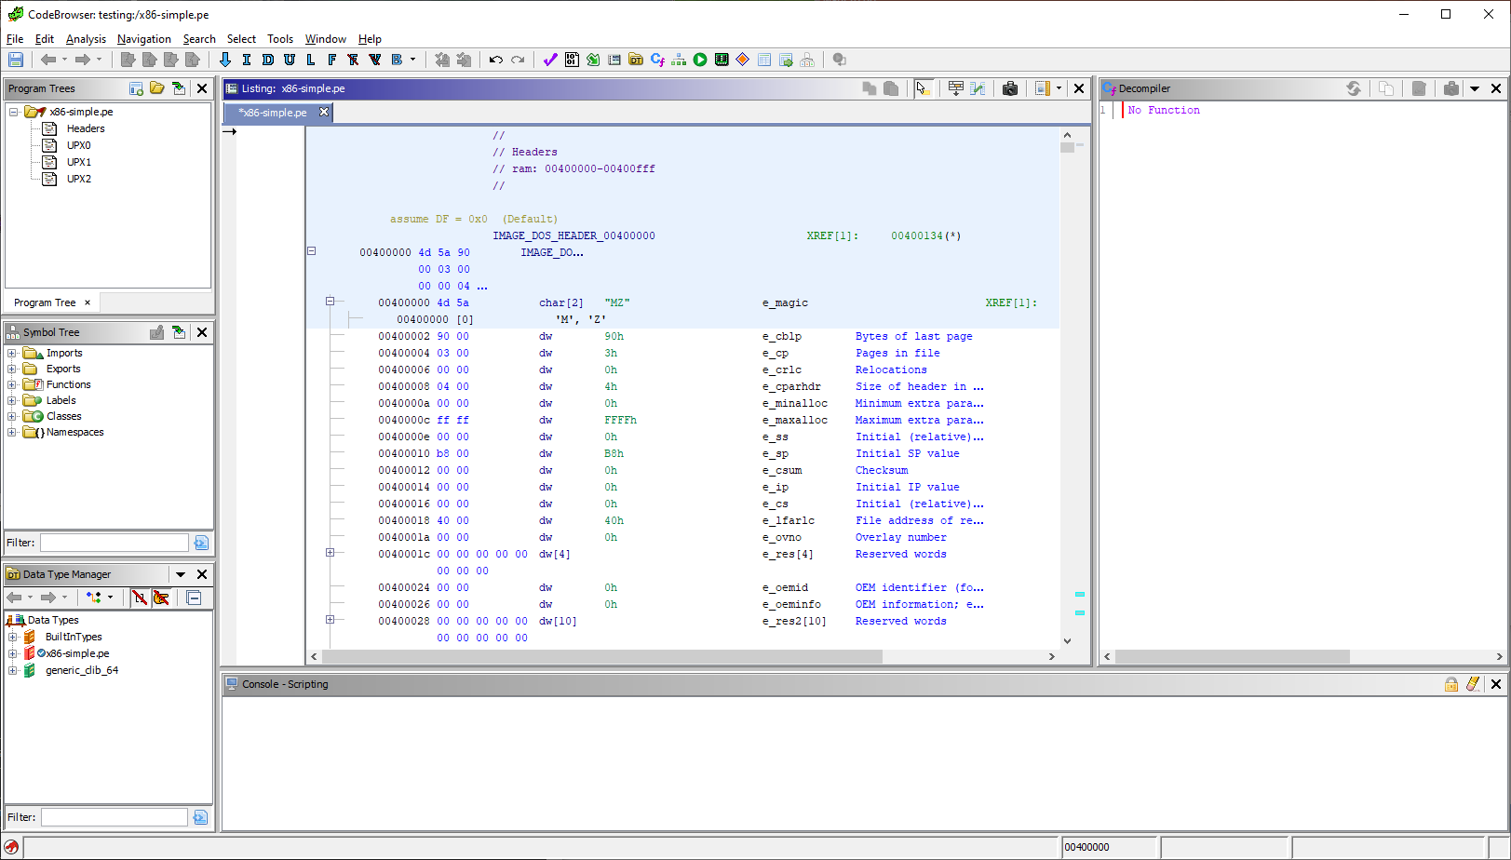

Slide 30
Debugger
Focus on:
Software / hardware breakpoint
Stepping and tracing
Memory address inspection
GDB
lldb
x64dbg
Immunity Debugger

Slide 31
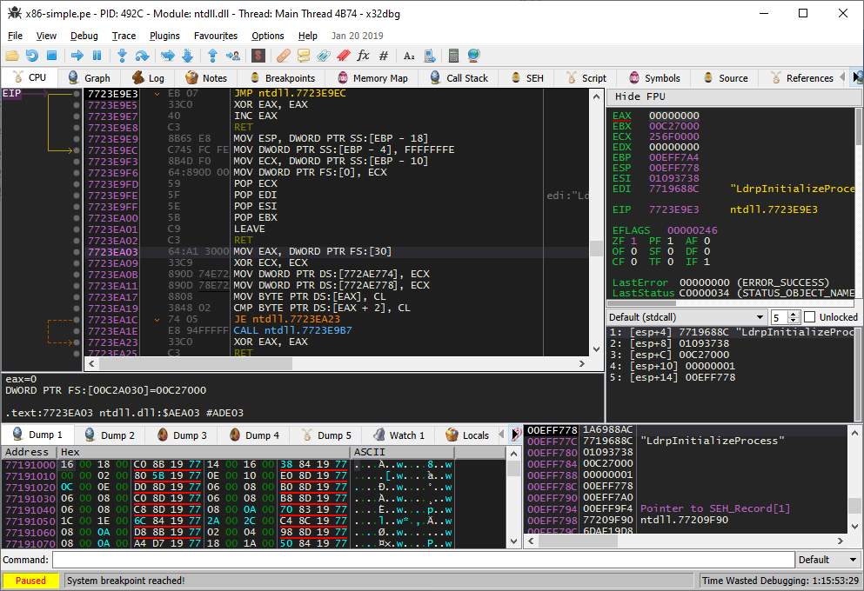

Slide 32
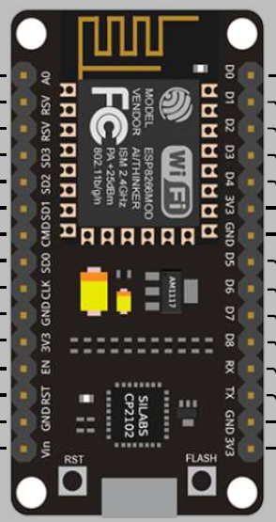

Case of Hardware Reversing
Machine
Code (Firmware)
32

Slide 33
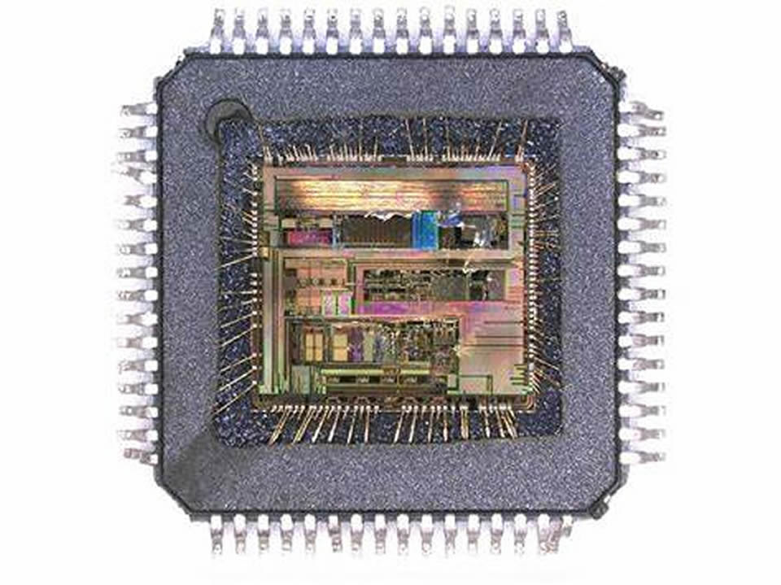
Chip Decap
Removing black epoxy packaging in order to expose the silicon
Unlock
Unlock IC and extract the program
Clone & Repurpose
Recreate the PCB

Slide 34
Tools
For Hardware Reverse Engineering
Bus Interface (JTAG, SPI, I2C, UART, GPIO)
Debuggers (SWD, JTAG)
Protocol Analyzer (USB, CAN)
Radio Frequency (Bluetooth, Zigbee, RFID)
https://github.com/ReversingID/Awesome-Reversing/blob/master/_hardware.md

Slide 35
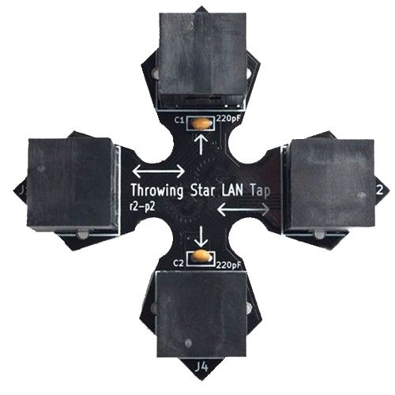
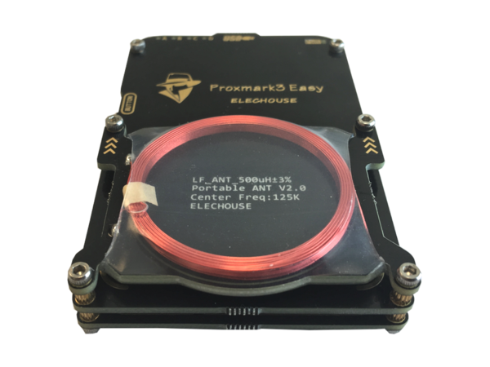

Slide 36
Case of Format Reversing
Pattern
Structure
Visualization

Slide 37

Format Analysis
Searching Pattern in Irregular Data
Pattern Matching
Byte Analysis
Structure Recognition

Slide 38
Tools
For Format Reverse Engineering
Format Identifier
Structure Parser
Binary Visualization
Pattern Search
Bundle Extractor
https://github.com/ReversingID/Awesome-Reversing/blob/master/_format.md

Slide 39

03
Challenges & Opportunities

Slide 40
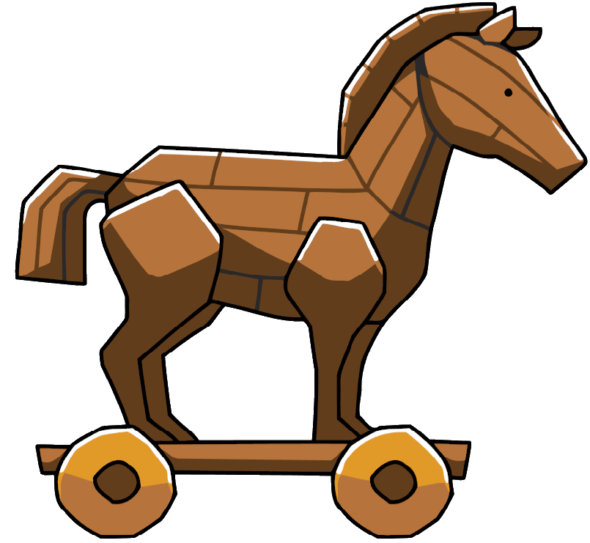


Malware Reversing
Discover artifacts
C2 server locations
Drop-in scripts/executables.
Exploits or vulnerabilities used.
Behavior analysis

Slide 41

Application Pentesting
Finding artifacts.
API endpoints.
Secret key.
Bypass functionalities.

Slide 42

Exploit Development
Finding bugs.
Mostly on closed-source application.
Finding set of gadgets.

Slide 43
Cheat & Mod Development
Modify game data
Modify values on memory.
Modify stored (saved) data on disk.
Identify data-structure (player, monster, etc) on memory.
Identify structure of network packets.
Modify game mechanics
Graphic related operation.
Modify Resources

Slide 44
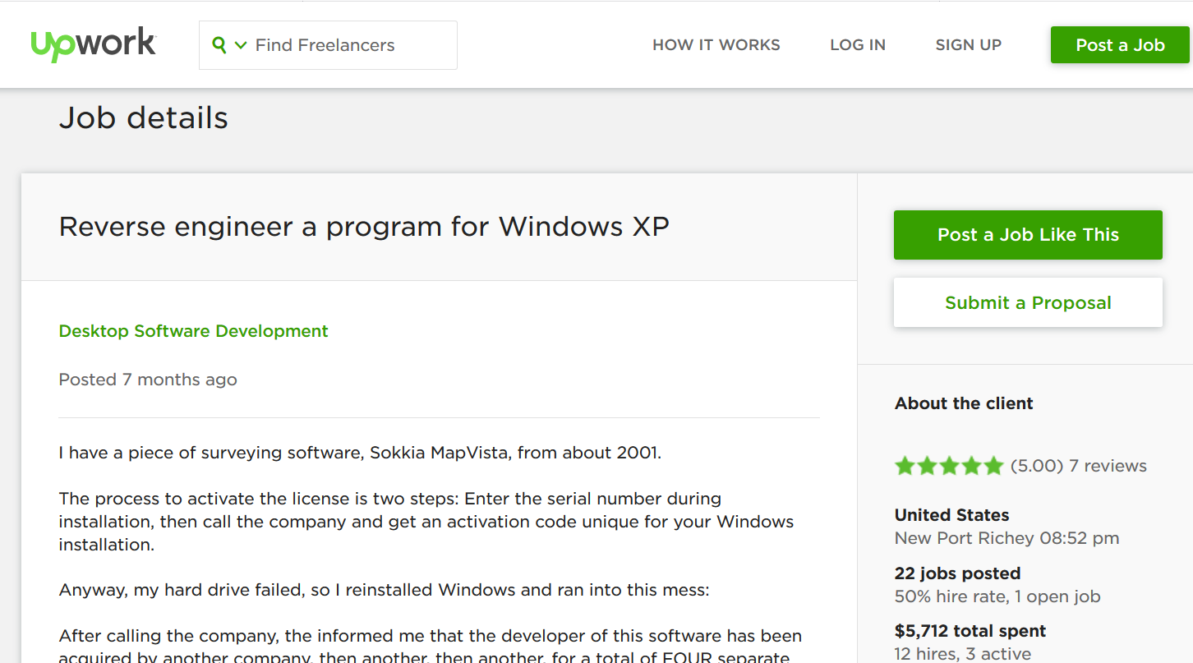
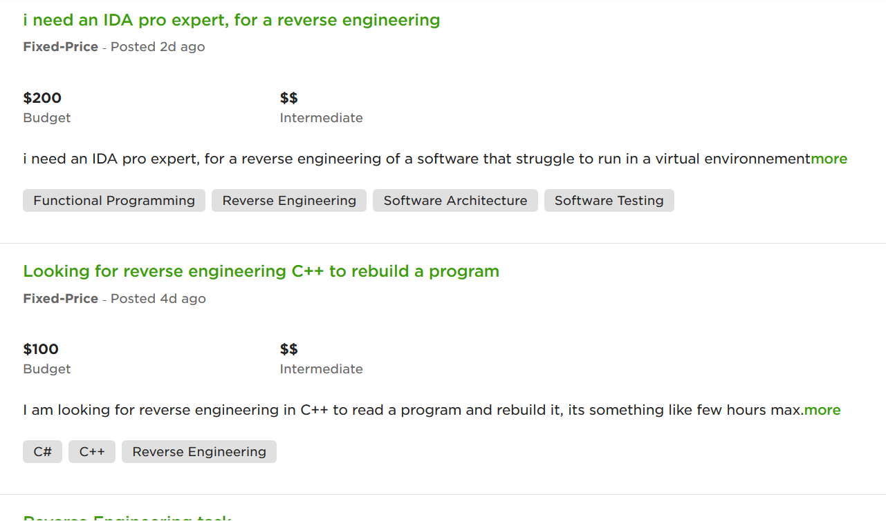
Free Lance

Slide 45
CREA
GREM
Certification
eCRE
CCMRE
Should? Should not?
Help employers evaluate potentials new hires.
Recognition of competency.
Papers? Talks?
Notes:
eCRE = eLearnSecurity Certified Reverse Engineer (https://www.elearnsecurity.com/certification/ecre/)
GREM = GIAC Reverse Engineering Malware (https://www.giac.org/certification/reverse-engineering-malware-grem)
CCMRE = CREST Certified Malware Reverse Engineer (https://www.crest-approved.org/examination/malware-reverse-engineer/index.html)
CREA = Certified Reverse Engineering Analyst (http://www.iacertification.org/crea_certified_reverse_engineering_analyst.html)

Slide 46
Challenges
Complexities
Keep up with engineering aspects:
Language, framework, libraries
Tools, environment
paradigm
Anti analysis mechanisms.
Law.

Slide 47
https://t.me/ReversingID
https://fb.me/Reversing.ID
https://github.com/ReversingID
https://Reversing.ID

Slide 48







THANKS
Satria Ady Pradana (xathrya)
+62 89 774 23935
xathrya@reversing.id
http://reversing.id
Question?

